Slide 1
Diabetic Retinopathy Detection using Machine Learning
presented by:

Slide 2
ABSTRACT:
Diabetic retinopathy is a disease caused by uncontrolled chronic diabetes and it can cause complete blindness if not timely treated. Therefore early medical diagnosis of diabetic retinopathy and it medical cure is essential to prevent the severe side effects of diabetic retinopathy. Manual detection of diabetic retinopathy by ophthalmologist take plenty of time and patients need to suffer a lot at this time. An automated system can help detect diabetic retinopathy quickly and we can easily follow-up treatment to avoid further effects to the eye. This study proposes a machine learning method for extracting three features like exudates, hemorrhages, and micro aneurysms and classification using hybrid classifier which is a combination of support vector machine, k nearest neighbour, random forest, logistic regression, multilayer perceptron network. From the results of the experiments, the highest accuracy values 82%. Hybrid approach produced a precision score of 0.8119,Recall score of 0.8116 and f-measure score of 0.8028.
Keywords-Diabetic Retinopathy, KNN, SVM, Random Forest, Retinal Fundus Images

Slide 3
LITERATURE SURVEY:
described a system for diabetic retinopathy grade classification based on fractal analysis and random forest using MESSIDOR dataset. Their system segmented the images, then computed the fractal dimensions as features. They failed to distinguish mild diabetic retinopathy to severe diabetic retinopathy. [Qomariah 2019] proffered an automated system for classification of Diabetic Retinopathy and normal retinal images using concurrent neural network (CNN) and support vector machine (SVM). Features comprised of exudates, haemorrhage and microaneurysms.

Slide 4
SYSTEM SPECIFICATION:
SOFTWARE REQUIREMENTS:
Operating system : Windows 7 Ultimate.
Coding Language : Python.
Front-End : Python console.
HARDWARE REQUIREMENTS:
System : Pentium IV 2.4 GHz.
Hard Disk : 40 GB.
Floppy Drive : 1.44 Mb.
Monitor : 14’ Colour Monitor.
Mouse : Optical Mouse.
Ram : 512 Mb.

Slide 5
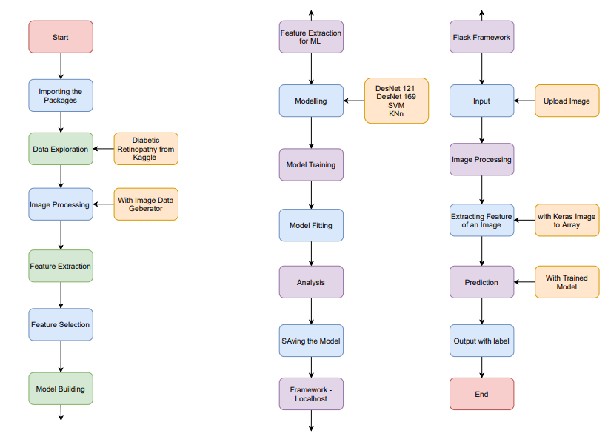
Flow chart:

Slide 6
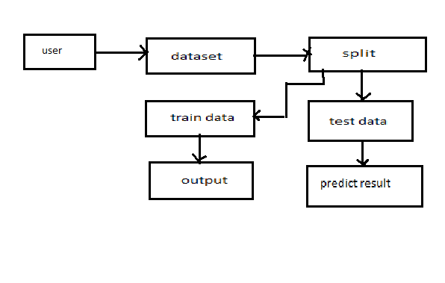
SYSTEM ARCHITECTURE:

Slide 7
CONCLUSION:
In this proposed method hemorrhages, exudates and microaneurysms are detected. For exudate detection green channel extraction, masking, smoothing, bitwise AND are done which results in better calculation and extraction of exudates. For detection of hemorrhages and micro aneurysms, morphological operations are performed like opening. Dilation and erosion operators are performed here. For diabetic retinopathy detection, count the number for MA occurred, count the number of hemorrhages occurred and count the number of exudates occurred in the image so we can decide the condition of image. Then features are calculated and feed to both SVM, KNN, Random Forest classifier. Voting of three classifiers are chosen as final prediction . So from the extracted feature it directly concludes the disease grade as normal or abnormal. So earlier detection and diagnosis of diabetic retinopathy help the patients from blindness and also the severe effects of disease can be decreases.

Slide 8
THANK YOU………

